Slide 1
MEDITATION
WEBSITE

Slide 2
What is meditation
Meditation is a practice where an individual uses a technique – such as mindfulness, or focusing the mind on a particular object, thought, or activity – to train attention and awareness, and achieve a mentally clear and emotionally calm and stable state.

Slide 3

Benefits of Meditation
Reduces Stress
Decreases Anxiety
Lowers Blood Pressure
Improves Sleep Quality
Improves Memory

Slide 4
Project Aims and Objectives
Research about the meditation and how it will reduce the mental health issues.
Investigate different techniques to design the website.
Implement the chosen design.
provide a website that sense of calm, peace, and balance, which can benefit user emotional well-being and overall health.

Slide 5
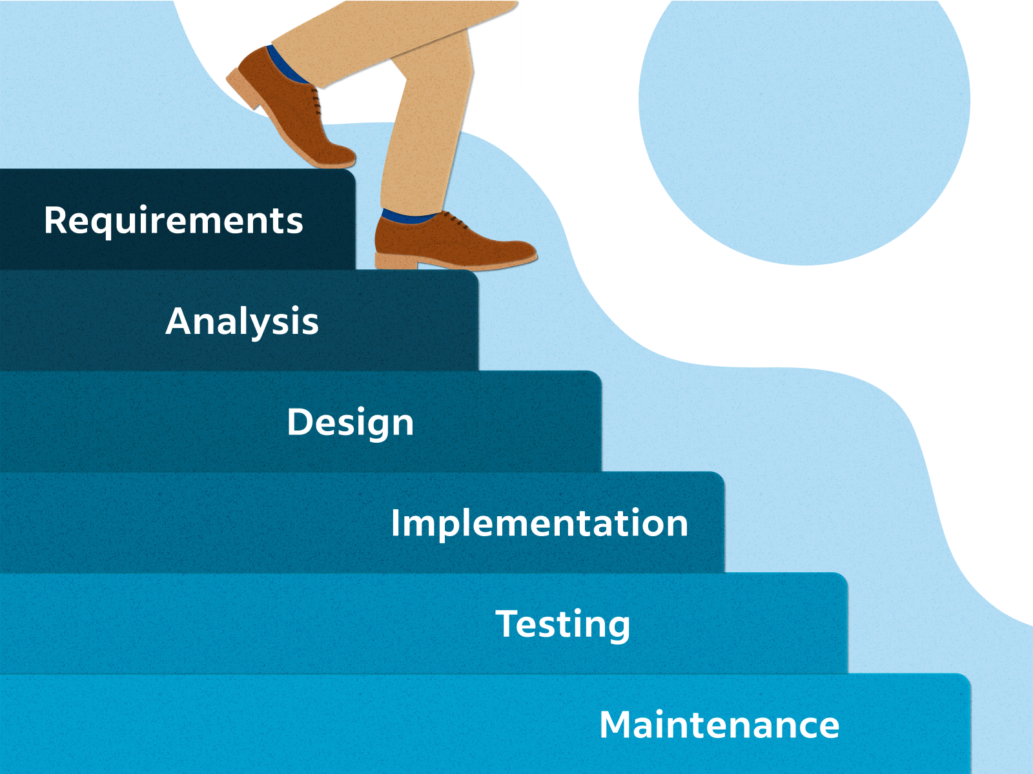
DESIGN
The waterfall model is a breakdown of development activities into linear sequential phases, meaning they are passed down onto each other, where each phase depends on the deliverables of the previous one and corresponds to a specialization of tasks.

Slide 6

Implementation
Creating Wireframes and Mockups
Choose a language
  HTML
  PHP
  CSS
Choose a Platform
  Visual studio code
  My SQL

Slide 7
Future Work
As future works it is worth considering whether allowing users to buy books from the website also need to improve the security system if the user able to perches an item from the website. As well as some features that can track the user stress level or some surveys. Moreover, in future I think add some live sessions to the website from that user will allow getting experience live.

Slide 8
Acknowledgement
I would like to Thank to Dr. Saad Mansoor for his support and guidance to create this meditation website. His experience and passion were key to making this project a reality. I also thank my family for their constant support and encouragement. Their faith in me and my work has always been a source of strength, and his knowledge and patience made this journey possible. Thank you to everyone who contributed so much to this project.

